Slide 1



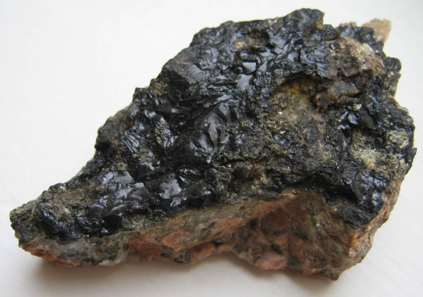
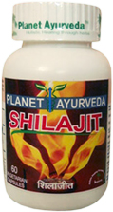
PLANET AYURVEDA
SHILAJIT CAPSULES
Healing Properties of Shilajit
Anti Ageing
Anti Diabetes
Anti Asthmatic
Anti Stress
Anti Arthritis
Shilajit for Increases Immunity
Shilajit for Sexual Dysfunction
Shilajit for Improve digestion
Shilajit for Anemia Treatment
Shilajit for Epilepsy
Shilajit for Skin Diseases
Shilajit for Depression, Stress
PLANET AYURVEDA
SHILAJIT CAPSULES
( Nature’s Best Herbo-Mineral )

Slide 2

PLANET AYURVEDA
SHILAJIT CAPSULES
(www.Planetayurveda.com)
Shilajit Names
Family name: Pedaliaceae
Sanskrit name: Shilajeet
English name: Mineral pitch
Scientific name: Asphaltum
Latin name: Asphaltum puniabiunum
Hindi name: Ral-yahudi
Origin of Shilajit
Shilajit comes from the Indian subcontinent and it oozes out from between the
cracks of rocks in the Himalayan Mountains.

Slide 3

PLANET AYURVEDA
SHILAJIT CAPSULES
(www.Planetayurveda.com)
What is Shilajit
Shilajit is considered the king herb of Ayurveda, the traditional Indian system of medicine. In Sanskrit the literal meaning of Shilajit is " Rock Like " - the power to make our body like a rock enabling it to withstand the ravages of time. Shilajit is a blackish-brown semisolid mass which is full of minerals, vitamins and other nutrients. According to Ayurveda, most curable diseases can be treated with Shilajit. Shilajit contains more than 85 minerals in Ionic form, including humic acid and fulvic acid.

Slide 4

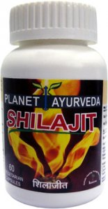
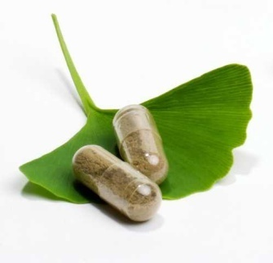
Benefits of Shilajit
Anti Ageing
Anti Arthritis
Anti Diabetes
Anti Anemia
Anti Asthmatic
Anti Stress
Anti Oxidant
Anti Obesity
Anti Cholesteremic Activity
Shilajit for Urinary Health
Shilajit for Sexual Health
Shilajit is One of
The Most Valuable Gift of Nature,
which has Astounding Benefits.

Slide 5

PLANET AYURVEDA
SHILAJIT CAPSULES
(www.Planetayurveda.com)
Shilajit – Best Anti Ageing Herbal Remedy
Shilajit is One of The Best Anti Ageing Remedy.
This halts ageing process in many ways. It gives strength to the bones, prevents depletion of calcium from the bones. Nourishes the nerves, rich in natural anti-oxidants, micro-nutrients, micro-minerals and thereby helping the body to keep the diseases away.

Slide 6

PLANET AYURVEDA
SHILAJIT CAPSULES
(www.Planetayurveda.com)
Shilajit For Sexual Health
Shilajit is a natural aphrodisiac and it has the ability to improve male sexual function. Since ancient times, shilajit was used to enhance energy and sexual performance. Shilajit supports and enhances libido, sexual thoughts, orgasms, genital organ sensation and pleasure. Shilajit is considered as the most important ingredient in Ayurvedic preparations for low sex drive and sexual weaknesses.

Slide 7


PLANET AYURVEDA
SHILAJIT CAPSULES
(www.Planetayurveda.com)
Shilajit For Diabetes
As in the individuals that are suffering from high blood sugar thus eventually are the victims of diabetes for them Pure Shilajit is very beneficial and is advised by the various ancient Ayurvedic texts from India.
Shilajit For Stress Relief
Shilajit is a rasayana (rejuvenative) herb and an adaptogen. An adaptogen acts nonspecifically to optimize function and help the body to adapt to physical and mental stress.

Slide 8

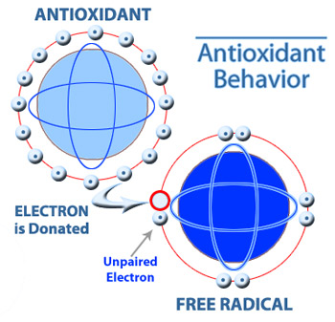
PLANET AYURVEDA
SHILAJIT CAPSULES
(www.Planetayurveda.com)
Shilajit for Arthritis or Joint Pain
The antioxidant and anti-inflammatory properties of Shilajit help to decrease and relieve joint inflammation and pain. Their effects on the neurotransmitters in the brain also seem to help relieve joint pain.
Shilajit as an Anti-oxidant Agent
Antioxidants can safely neutralize a free radical without becoming a free radical them self. Shilajit is a powerful antioxidant that has an added benefit of being able to cross the blood-brain barrier. Thus it is even used for the purpose to reverse the senile changes.

Slide 9

PLANET AYURVEDA
SHILAJIT CAPSULES
(www.Planetayurveda.com)
Shilajit For Obesity or Weight Loss
Excellent results have been discovered when shilajit is applied in medo roga (obesity). It possesses this property because of its laghu (light) and ruksh (dry) properties. It helps in scrapping away of extra fat accumulated in body thus helps in providing slim and healthy looks to the body.

Slide 10

PLANET AYURVEDA
SHILAJIT CAPSULES
(www.Planetayurveda.com)
More Benefits of Shilajit
Shilajit maintains the blood sugar level.
Shilajit purifies blood, increases appetite and increases the efficiency of pancreatic gland.
Shilajit increases the energy responsible for your sexual and spiritual power.
Shilajit enhance the working of the immune system and Improves recovery after exercise.
Most Important, it increases stamina, sexual power and erectile dysfunction among men.
Shilajit has been used for general physical weakness, blood sugar stabilization, libido,
Injury healing, urinary tract rejuvenation, enhanced brain functioning potency, bone healing, kidney rejuvenation, hypertension, obesity.
Shilajit is a Miracle Herbo-Mineral, Which Provide Cure from Number of Ailments

Slide 11

Where to Buy Shilajit in the form of Capsules
Planet Ayurveda and Krishna Herbals companies are the major manufacturers of Shilajit in India.
They are the leading suppliers of Shilajit to many countries.
Unique Features of Our Product
Our Shilajit capsules are packed in Packed in Vegeterian capsule shells.
Our Shlajit capsules contains fresh Shilajit extract sourced from himalayan mountains and is rich in natural fulvic acid content which is the major reason for activity of Shilajit.
Our Shilajit Capsules are not mixed with fillers, chemicals, herb powders and are manufactured in world's best qualtiy GMP certified factory and is of export quality.
We do not use fillers to fill in the empty space in the capsules. We use only pure standardized shilajit extract.

Slide 12

Shilajit Capsules from Planet Ayurveda, India are pure and natural. We believe in good quality and we are using 100 % vegetarian capsules made from plant cellulose and not from hard gelatin which are low in cost and are made from chemicals. We are filling 500 mg standardized herbal extracts in our vegetarian capsule shells while many other manufacturers are filling 250 mg herbal extracts or raw herb powder.
Side Effects of Shilajit Capsules
Shilajit has no contraindication and is completely safe for consumption.
No side effect has been reported with the continuous use of Shilajit, but the medicine should be used with proper medication and consultation by the physician.

Slide 13
PLANET AYURVEDA
SHILAJIT CAPSULES
(www.Planetayurveda.com)
FAQ’s on Shilajit Capsules
Q1: Can Shilajit Capsules be used by females or not?
Ans: Yes, the females can effectively use Shilajit capsules but with proper consultation with the
concerned physician.
Q2: Should the Shilajit capsules be taken with water or milk?
Ans: It can be taken both with milk and water.
Q3: What are main constituents of Shilajit capsules?
Ans: Fulvic acids, Dibenzo Alpha Pyrones, Humic Acids and trace materials
Q4: Where to buy 100% pure, effective and cheap shilajit capsules online from India?
Ans: Planetayurveda and Krishnaherbals companies are the major manufacturers of Shilajit in India. They are the leading suppliers of Shilajit to many countries.
Q5: What are the side effects of regular intake of Shilajit capsules?
Ans: No, There is no any side effects of shilajit capsules has been reported till date.

Slide 14
Packs | Retail Price | Sale Price | Order Now
1 Bottle | $24.95 | $22.95 | Min 2
2 Bottles | $49.90 | $42.95 | Buy Now
3 Bottles | $74.85 | $61.95 | Buy Now
5 Bottles | $124.75 | $97.95 | Buy Now
10 Bottles | $249.50 | $183.95 | Buy Now
Free Shipping and Handling Worldwide!
Servings Per Container – 60 Capsules
Dosage of Shilajit Capsules – 2 capsules twice daily, with plain water or milk after meals.
You Many Also Buy Shilajit Capsules online from our Official Websites –
www.Planetayurveda.com (www.planetayurveda.com/shilajit.htm)
www.Krishnaherbals.com (www.krishnaherbals.com/shilajit-capsules.html)

