Slide 1
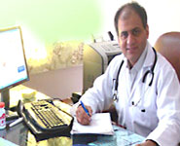
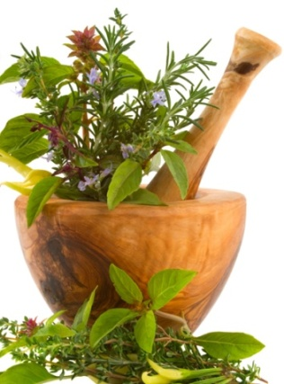
LIVER CIRRHOSIS – AYURVEDIC TREATMENT
Dr. Vikram Chauhan is One of the most
Promising Ayurvedic doctors in the world
and a senior consultant physician from India.
He has 12 years of international exposure &
treated patients of all ages and all races and
complicated diseases like Liver Cirrhosis.
Here are some Ayurvedic remedies mentioned in this presentation which can be used along with ongoing treatments without any side effects !
All herbs are well researched and have documentary evidence of their positive role in liver diseases.
Dr. Vikram Chauhan
BAMS, M.D.Ayurveda
Consultant Ayurvedic Physician
Planet Ayurveda Healing Center
Chandigarh,India

Slide 2
What is Planet Ayurveda?
Planet Ayurveda is a leading herbal GMP certified manufacturing, export company – owned by Dr. Vikram Chauhan from Chandigarh, India.
It is an ISO 9001:2008 and sister concern of Krishna Herbal Company which is US-FDA registered company
Planet Ayurveda has distributors in various parts of the world and products range over 200 and millions of regular users of Ayurvedic products.
Planet Ayurveda is an Ayurvedic treatment center in Chandigarh India and has branches in many parts of the world.

Slide 3
What is Liver Cirrhosis
Cirrhosis is a slowly progressing disease in which healthy liver tissue is replaced with scar tissue, eventually preventing the liver from functioning properly
There are 3 stages of Liver Disease
Fatty Liver
Inflamed Liver (Hepatitis)
Liver Cirrhosis ( Liver Fibrosis )
LIVER CIRRHOSIS CAN BE CURED IN MANY PATIENTS USING AYURVEDIC MEDICINES AND HERBS

Slide 4
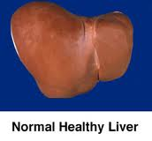
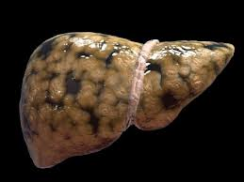
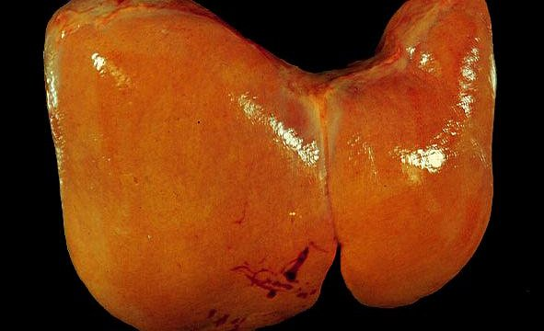
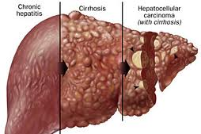
NORMAL LIVER- FATTY LIVER – INFLAMED LIVER AND LIVER CIRRHOSIS & Liver Cancer
Fatty Liver
Liver Cirrhosis
& Cancer
Fatty Liver & Hepatitis

Slide 5
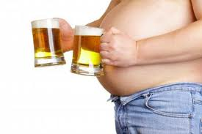
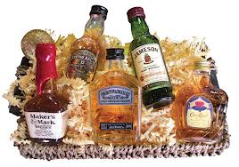
CAUSES OF LIVER CIRRHOSIS
# 1 – ALCOHOL
Alcohol intake is the leading cause of Liver cirrhosis.
Liver is seat of “Fire” and alcohol it self is fire &
increases the heat so much so that it burns the
liver cells.
Initially it all starts with fatty liver !

Slide 6
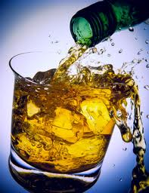
What ALCOHOL does to Liver ?
Alcohol is a toxin to liver cells & they have to
work hard to metabolize it. many liver cells
die in the process, & their dead bodies are
covered with scar tissue – called liver cirrhosis
ALCOHOL BURNS THE LIVER CELLS !!
The enzymes which are required to process the food are working to clear the alcohol from the body and neutralize it, but too much quantity leads to their defeat and death. This causes liver cirrhosis.

Slide 7
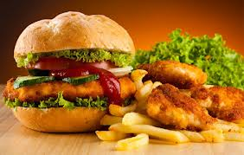
More Causes of Fatty Liver – Hepatitis & Cirrhosis
Alcohol Fast Food

Slide 8
More Causes of Fatty Liver – Hepatitis & Cirrhosis
Poor Nutrition

Slide 9
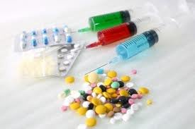
More Causes of Fatty Liver – Hepatitis & Cirrhosis
Viral Infections – Causing Hepatitis A, B, C,D,E, F, G
Drugs - anti-biotics, pain killers

Slide 10
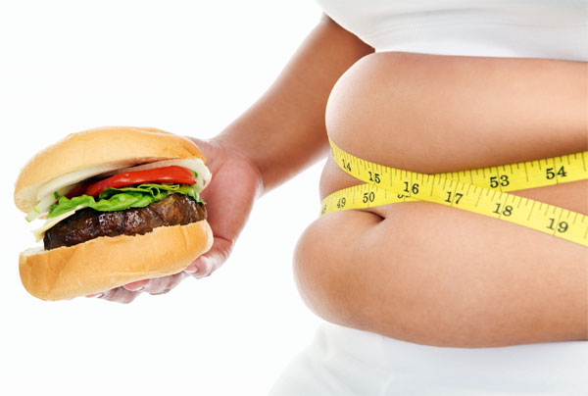
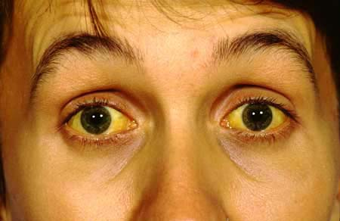
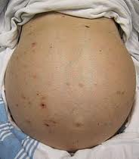
Symptoms of Liver Damage – 3 stages
# 1 Fatty Liver – Poor Appetite, Flatulence, Lack of energy, fatigue, Stomach upset, dull Pain in the right flank
# 2 Inflammed Liver (Hepatitis ) – Jaundice, Clay colored stools, Dark colored urine, pale yellowish skin, yellow eye balls, pain in left flank, weakness,
# 3 Liver Cirrhosis – All of the above &

Slide 11
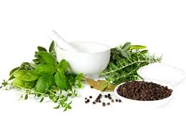
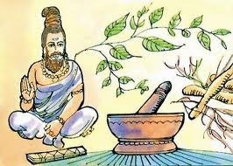
AYURVEDIC HERBS CAN CURE LIVER DISEASES
Ayurveda - The age old system of healing of India can actually cure liver diseases by use of herbs, minerals, detoxification, diet modification and yogic exercises.
AYURVEDA CAN ACTUALLY REVERSE LIVER DAMAGE AND LIVER DISEASE ! !

Slide 12
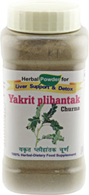
AYURVEDIC HERBS FOR LIVER DISEASES
1. BHUMIAMLA ( An Ingredient in Yakrit Plihantak Churna )
2. BHRINGRAJ ( An Ingredient in Yakrit Plihantak Churna )
3. KATUKI ( An Ingredient in Yakrit Plihantak Churna )
4. PUNARNAVA ( An Ingredient in Yakrit Plihantak Churna )
5. SHARPUNKHA ( An Ingredient in Yakrit Plihantak Churna )
6. MAKOY ( An Ingredient in Yakrit Plihantak Churna )
7. KALMEGH ( An Ingredient in Yakrit Plihantak Churna )
8. KAASNI ( An Ingredient in Yakrit Plihantak Churna )
AYURVEDA CAN ACTUALLY REVERSE
LIVER DAMAGE AND LIVER DISEASE ! !

Slide 13
YAKRIT PLIHANTAK CHURNA- NATURE’S LIVER HEALING FORMULA
ALL 8 INGREDIENTS IN YAKRIT PLIHANTAK CHURNA
ARE HIGHLY RESEARCHED WORLDWIDE
THOUSANDS OF RESEARCH PAPERS PUBLISHED ON ALL
THESE INGREDIENTS
ALL SHOWED 100 % POSITIVE ROLE IN HEPATITIS,
FATTY LIVER AND LIVER CIRRHOSIS
AYURVEDA CAN ACTUALLY REVERSE
LIVER DAMAGE AND LIVER DISEASE ! !

Slide 14
USES OF YAKRIT PLIHANTAK
FATTY LIVER & HEPATITIS A , B , C , D, E, F, G
JAUNDICE
CONSTIPATION
LOW APPETITIE, LACK OF ENERGY, WEAKNESS,
GAS, ACIDITY & FLATULENCE
TO NEUTRALIZE THE SIDE EFFECTS OF ALCOHOL
TO NEUTRALIZE THE SIDE EFFECTS OF FAST FOOD
LIVER FAILURE AND LIVER CIRRHOSIS DUE TO
ANY REASON
ALL SKIN DISORDERS AND IMPURITIES IN BLOOD
NATURAL LIVER DETOXIFICATION
EFFECTIVE WEIGHT LOSS ! !
YAKRIT PLIHANTAK CHURNA IS RECOMMENDED FOR EVERYONE ! !

Slide 15
How to take – Yakrit plihantak Powder
1 TEASPOONFUL TO 1 TABLESPOONFUL TWICE DAILY WITH WARM WATER , AFTER 1 HR. OF MEALS
OR
BOIL 1 TABLESPOONFUL OF HERBS IN 400 ML WATER, KEEP IT BOILING UNTIL IT REMAINS 50 ML. STRAIN THE DECOCTION AND CONSUME IT. LEAVE THE RESIDUE AND ONCE DAILY IS ENOUGH
HERBS IN YAKRIT PLIHANTAK CHURNA ARE RECOMMENDED FOR EVERYONE ! !

Slide 16
For Physical Health
FOOD – SLEEP & EXERCISE
Food - Don’t eat junk.
Diet - Do you put Kerosene in your car ever ? The manufacturer of a car gives you a manual to put premium petrol in your car and you follow the instructions.
Similarly God / Nature - who is the manufacturer of our body gave the manual- Ayurveda with instructions to lead life and use natural food like- Grains, Cereals, Nuts, Fruits, Vegetables, Seeds, Roots, Shoots, Spices and Herbs. Why we eat food from the shelf ? Why we buy Carbon dioxide ( from Soft drinks) to drink ?

Slide 17
Sleep- Important to Relieve Stress Damage
Body repairs the damage during sleep.
Automatic system in the body – Retina sends signals to brain to shut down. Brain sends signals to organs to shut down, slow down.
BP falls, Heart rate falls, Respiration falls, but you don’t want to sleep. You want to feed your senses- You are sending “FOOD” in your system late at night. The body wakes up.. Can’t digest it..
Melatonin – Anti-aging neurotransmitter secreted from the pineal gland in brain – responsible for dark cycle maintenance and prevention of cancer and other diseases – it comes out only when we sleep.

Slide 18
For Mental Health
Balanced thoughts, Positive thinking.
Get rid of Anger, Hatred, Jealousy, Greed, Hypocracy, Lies, Stealing, Violence.
Liver generates all the chemicals needed to create these emotions. It has to work hard to eliminate them ! !
All these can be corrected by – Good Books and company of Good People – i.e. Satsang (Company of Truthful people)

Slide 19
The Financial / Physical / Mental health
The Financial Health – Career, Money can be attained , status can be maintained if there is no physical ailment or mental stress.
Physical Health - FOOD, SLEEP, EXERCISE- Necessary to keep good physical fitness & make money.
Mental Health- Good books, Good people – helps you to win jealousy, greed, anger and hatred- leads you to happiness, peace of mind and good financial health.

Slide 20
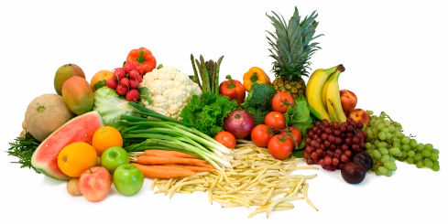
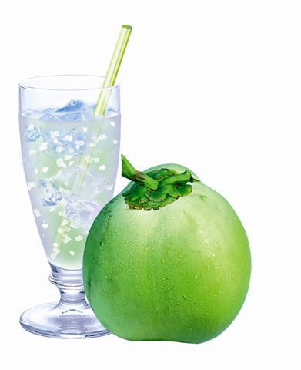
DIET IN LIVER DISEASES – LIVER FAILURE
ADVISED
Coconut Water
Radishes
Fresh vegetable soups, salads, juices
Sugarcane juice
AVOID
Alcohol
Smoking
Non-Veg, Packaged food
Frozen food, Artificial food
Junk Food, High protein diet
Soft Drinks
Pain Killers
Citrus fruits and Yogurt and heavy,
greasy, cheesy diet

Slide 21
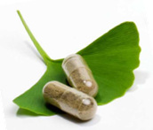
YAKRIT PLIHANTAK - THE BEST HERBAL COMBINATION FORMULATED BY Dr. VIKRAM Chauhan – MD ( AYURVEDA)
YAKRIT PLIHANTAK CHURNA – THE BEST HERBAL COMBINATION FOR SKIN, CONSTIPATION, GAS, FLATULANCE, ACIDITY, ABDOMINAL DISCOMFORT, FATTY LIVER, LIVER FAILURE, JAUNDICE, WEAKNESS, OVER WEIGHT PEOPLE
Dr. Vikram Chauhan – MD (Ayurveda)

Slide 22
YAKRIT PLIHANTAK CHURNA
An effective Herbal Remedy for liver diseases.
A powerful combination to reverse liver diseases without side effects.
Improves skin texture, general strength, appetite.
Combination of pure natural herbs.
Improve natural sleep and helps in constipation.
Helps in Anger, anxiety, forgetfulness and lack of concentration.

Slide 23
Side Effects
No side effects have been reported so far as
Yakrit plihantak churna is prepared from the pure
and natural herbs.
Dosage
1-2 teaspoonfuls twice a day after the meal with plain water.

Slide 24
BUY YAKRIT PLIHANTAK CHURNA
@
WWW.PLANETAYURVEDA.COM
Quantity – 200 gram herbs powder ( Wild Crafted )
Price – $ 42.95 ( For 2 Bottles

Slide 25
About Company (Planet Ayurveda)
US-FDA registered herbal company.
Exporting natural products and supplements to US, Europe, Singapore, Malaysia, Australia, Japan, Africa.
A GMP certified manufacturing unit located near Shivalik range of Himalayan mountains.
Headed by MD (Ayurveda- herbal pharmacology Expert doctor).
Website – www.planetayurveda.com
Contact Us
#3604, Sector 23-D,
Chandigarh-160023 -INDIA
Phone – +91-172-5073604 (Work)
Fax - 0091-172-3054840 (Work)
Cell Phone - Manager - 0091-9915593604
E Mail ID - Customer Care - herbalremedies123@yahoo.com
Website -www.planetAyurveda.com & www.Krishnaherbals.com

